Slide 1


2nd International Conference on Recent Trends in Artificial Intelligence and Data Science (ICRTAIDS-2025) Organizer Department of Artificial Intelligence and Data Science AJEENKYA D Y PATIL SCHOOL OF ENGINEERING, LOHEGAON, PUNE
Improving AI Strategies in Othello
Track ID: 1_129
College Name: Ajeenkya D Y Patil School Of Engineering, Lohegaon, Pune
Group Name: : LOBO 2.0
Group Members:
Atharva Hadap
Siddhi Bhaskar
Durga Dhembare
Tushar Bagul
Guide Name: Prof .Priyanka Bhore

Slide 2
Outline
Introduction
Motivation
Problem Statement
Aims and Objectives
Literature Survey
Existing System
Proposed System
Algorithm and Modules
Implementation
Conclusion
Reference

Slide 3
Introduction
AI Techniques in Othello – Othello, like Chess and Go, is a complex strategic game that has been a major focus in AI research. Methods like deep reinforcement learning and advanced search algorithms are commonly used to develop intelligent agents. Challenges in AI Development – Othello's dynamic gameplay and large search space make AI development difficult, requiring a balance between computational efficiency and strategic accuracy. Learning Classifier Systems (LCS) help navigate the game’s state space by evolving rule-based decision-making over time.
Key AI Approaches :-
Minimax with Alpha-Beta Pruning
Monte Carlo Tree Search (MCTS)
Reinforcement Learning (RL)

Slide 4
Motivation
AI has revolutionized board game strategies, with Othello serving as a key testbed due to its simple rules yet complex decision-making. This research explores AI challenges in Othello, optimizing Minimax through heuristics to enhance gameplay. These advancements extend to broader AI applications in decision-making and game theory.
AI in Board Games
Board games like Othello serve as an excellent testbed for artificial intelligence strategies.
Challenges in AI for Othello
Despite its simple rules, Othello presents complex decision-making challenges that require efficient search and evaluation technique
Real-world Implications
Advances in AI strategies for Othello can be applied to broader AI fields, such as decision-making systems and game theory.

Slide 5
Problem Statement
The game of Othello requires strategic decision-making and optimal move selection.
Existing Minimax-based AI approaches have limitations in handling deep game trees effectively.
There is a need to improve AI strategies in Othello by optimizing Minimax and exploring advanced enhancements.

Slide 6
Aims and Objectives
Aim:
To enhance AI strategies in Othello by improving the Minimax algorithm for better decision-making and gameplay performance.
Objectives:
Implement and optimize the Minimax algorithm for Othello.
Explore heuristic evaluation functions to improve AI decision-making.
Compare the performance of different AI strategies in Othello.
Analyse the impact of pruning techniques like Alpha-Beta pruning on AI efficiency.
Develop an AI model that adapts dynamically to different game scenarios.

Slide 7
Literature Survey
Title | Author | Methodology | Experimental Results
An evolutionary learning approach to play Othello using xcs. | Satvik Jain , Siddharth Verma , Swaraj Kumar & Swati Aggarwal | Use extended classifier system , learning classifier system , enforcement learning , genetic algorithm. | The effectiveness of using XCS algorithm to construct a gameplaying AI agent for Othello has been established by obtaining favourable results when made to compete against 3 different categories of agents: minimax, human and random agent. Preference
Preference learning for move prediction and evaluation function approximation in Othello. | Thomas Philip Rulnarsson , Simon M Lucas | Computational and artificial intelligence, tuple, preference learning, temporal difference learning, Othello. | Compared the preference learning approach with LSTD, with MM, and with a more standard classification approach. Computing
Computing Games: Bridging the Gap Between Search and Entertainment. | ANGGINA PRIMANITA ,MOHD NOR AKMAL KHALID ,HIROYUKI IIDA | Search algorithm, game tree, entertainment, single agent game, puzzle game, single conspiracy number. | Interesting direction worth venturing includes verifying further the feasibility of PPNS and SCN in multiplayer games and non-game context.

Slide 8
Existing System
Traditional AI Strategies in Othello
Rule-based approaches and heuristics
Static evaluation functions to assess board positions

Slide 9
Proposed System
Understanding Othello Rules
Alpha-Beta Pruning
An optimization for Minimax to reduce the number of nodes evaluated. It helps in faster decision-making by cutting off unnecessary branches.
Othello is an 8×8 strategy game where players flip opponent discs to control the board and win.
Minimax Algorithm
Heuristic Evaluation Function
Mobility: Number of valid moves available.
Stability: Corner and edge control.
Parity: Number of discs at the end of the game.
Minimax is a decision rule for minimizing the possible loss in worst-case scenarios. In Othello, it evaluates board states by simulating future moves and their outcomes

Slide 10
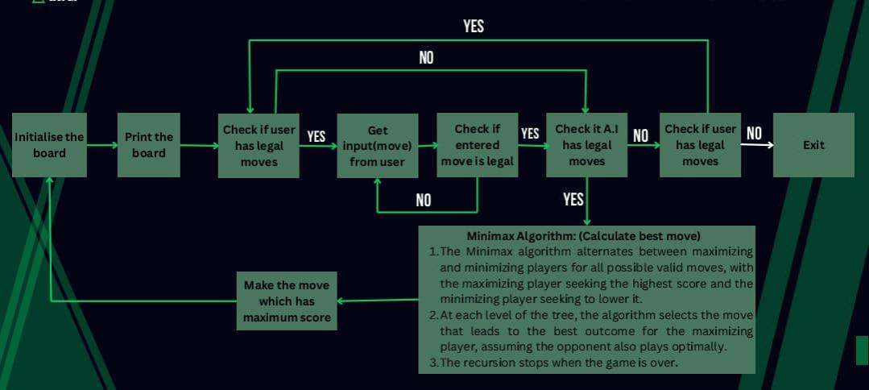
Proposed System

Slide 11
Algorithm and Modules
Various algorithms and modules used in the
Algorithms:-
Minimax Algorithm
Alpha-Beta Pruning
Evaluation Function
Monte Carlo Tree Search (MCTS)
Modules:-
Game Board Representation Module
Move Generation Module
AI Decision-Making Module
Evaluation Modul
User Interface Module
Training/Testing Modul

Slide 12
Implementation
In Implementation we are used various types of Methodes
Monte Carlo Simulation (Optionna Enchantement)
Alpha-Beta Pruning
Minimax Algorithm Implementation

Slide 13
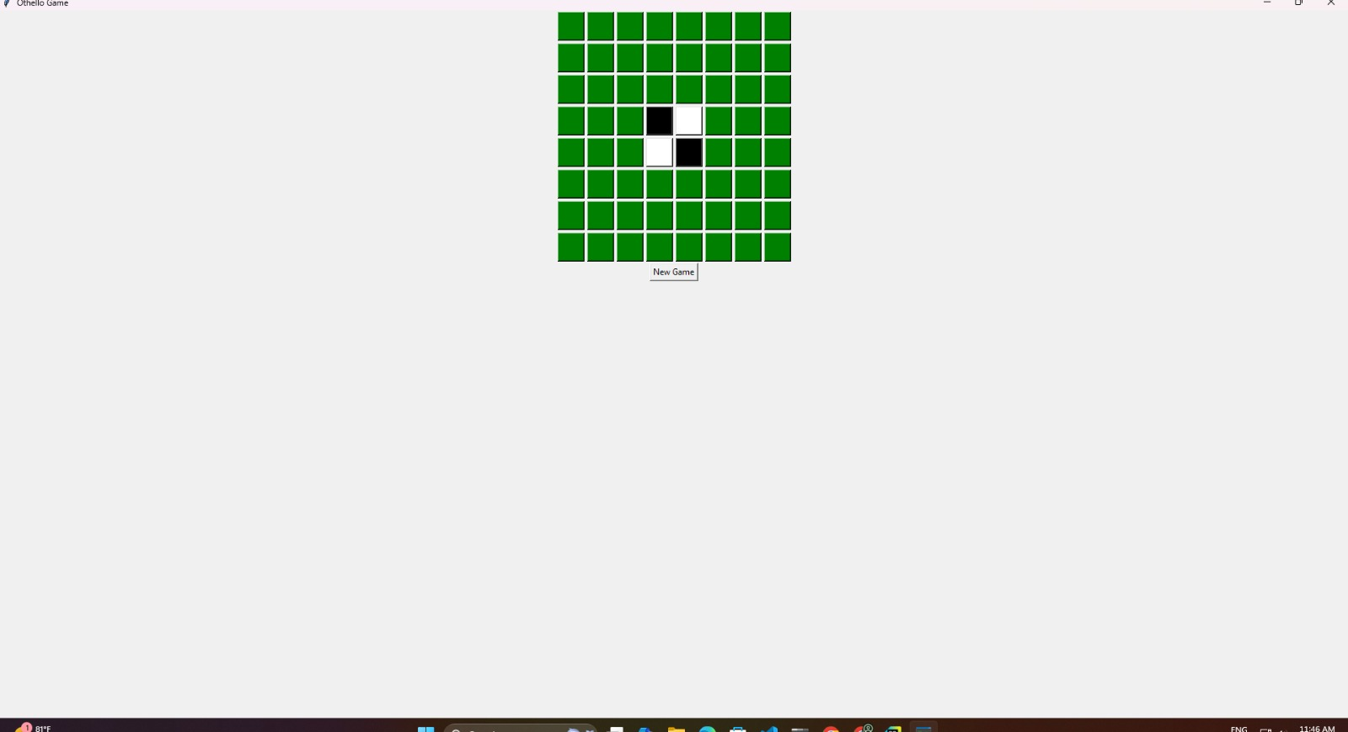
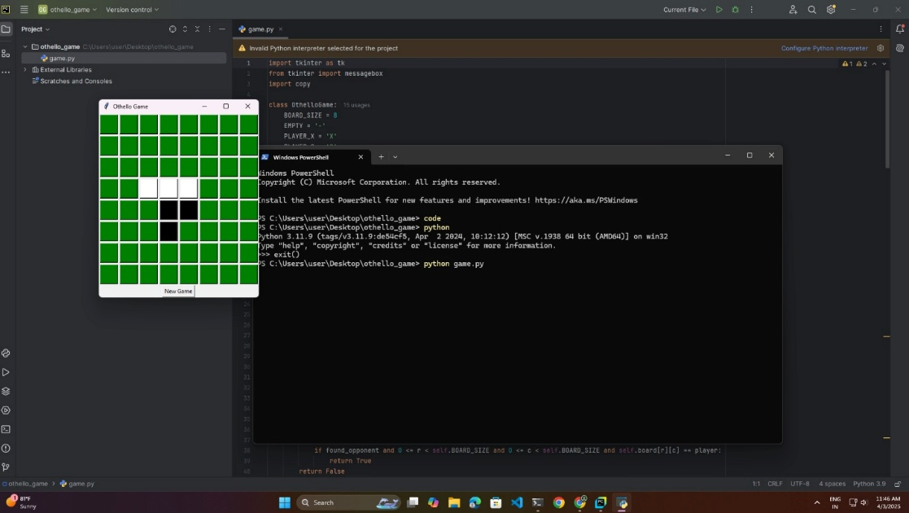
Implementation

Slide 14
Future Scope
Improving AI adaptability by integrating deep learning techniques
Enhancing performance using more advanced Reinforcement
Learning models.
Implementing an online multiplayer mode for user interaction.
Expanding the AI’s capabilities to other board games beyond Othello

Slide 15
Conclusion
The study successfully demonstrates the effectiveness of the Minimax algorithm in improving AI performance in Othello. Heuristic evaluation functions play a crucial role in enhancing AI decision-making and optimizing board control. Experimentation shows that depth-limited search balances computational efficiency and decision quality. Future work can focus on integrating machine learning techniques to refine heuristics and further improve AI strategies. The findings contribute to the broader field of AI in game theory and strategic decision-making, highlighting the potential for hybrid AI models

Slide 16
References
Satoshi Ikeda, Tomoyasu Toshimori, Makoto Sakamoto and Takao Ito, “A Perfect Play on 4*12 Board of Othello”, Vol. 9(4), pp.331-336, 2023
Anggina Primanita and Mohd Nor Akmal Khalid, “Computer Games: Bridging the Gap Between Search and Entertainment”, Vol. 9, 2021
Takanobu Yaguchi and Hitoshi Iima, “Design of an Artificial Game Entertainer by Reinforcement Learning”, pp.1-4, 10.1109/CoG47356.2020.9231551, 2020
S. Varma, S. Kumar, and S, Aggarwal, “An Evolutionary Learning Approach to Play Othello Using XCS”, pp. 1-8, 10.5555/978-1-5090-6017-7, 2018
T. Philip Runarsson and Simon M. Lucas, “Preference Learning for Move Prediction and Evaluation Function Approximation in Othello”, no.14, pp.300-313, 2014

Slide 17
Thank You

